Slide 1
Medical Insurance Presentation
HEALTHCARE PRESENTATION · MACHINE LEARNING PROJECT
Team & roles
HR
Harsh Raj
Documentation Lead
PK
Prem Kiran Gedala
PPT Lead
Predicting annual medical insurance charges from age, BMI, smoking habits and other health-related details.
RA
Rakshith A Y
Video Lead
NM
Nikhil Meena
Execution Lead
GitHub github.com/Harsh-IIT-Ropar/insurance-cost-prediction
Notes:
Medical insurance cost prediction using Linear Regression. Team roles: Harsh Raj (Documentation), Prem Kiran Gedala (PPT), Rakshith A Y (Video), Nikhil Meena (Execution).

Slide 2
Problem and data
2
A realistic synthetic healthcare insurance dataset for regression
What and why
7,500
22
A realistic synthetic healthcare insurance dataset created for machine learning, data science, healthcare analytics and AI-based prediction projects. It contains demographic, lifestyle, medical history, chronic disease, hospitalization and insurance-related information of individuals along with their annual medical costs.
rows
columns
TARGET VARIABLE
Designed for
annual_medical_cost_usd
Medical Insurance Cost Prediction
Healthcare Analytics
Risk Assessment Systems
Regression ML Projects
Predictive Modeling
AI Healthcare Dashboards
Dataset type Structured Tabular Data
Data Visualization & EDA
Feature Engineering Practice
ML problem type Regression
Notes:
Dataset: 7,500 rows, 22 columns. Target variable is annual_medical_cost_usd. Structured tabular data; regression problem.

Slide 3
Approach
3
Project pipeline: dataset → model → prediction
1
2
3
4
5
Dataset Collection
›
Data Preprocessing
›
Model Training
›
Model Testing
›
Final Prediction
Medical insurance dataset
Cleaning and encoding data
Linear Regression
Compare predicted and actual costs
Estimated annual insurance cost
Approach Used – Linear Regression
Libraries used
Linear Regression is a supervised Machine Learning algorithm used to predict continuous numerical values.
In our project, it predicts annual medical insurance charges based on different input factors such as age, BMI, smoking habits and other health-related details.
1
numpy
2
pandas
3
matplotlib
4
scikit-learn
5
seaborn
Notes:
Pipeline: dataset collection, data preprocessing (cleaning and encoding), model training with Linear Regression, model testing, and final prediction of annual insurance cost. Libraries: numpy, pandas, matplotlib, scikit-learn, seaborn.

Slide 4
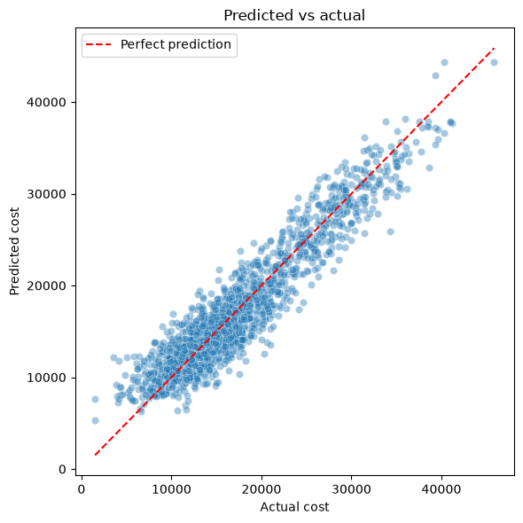
Results
4
After training and testing, the model predicts medical insurance costs from the input information
R² score
RMSE
MAE
0.8852
2516.85
2019.69
test set
USD
USD
Important performance metrics
The model explains about 88.5% of the variation in annual medical cost on the test set, with a typical error of about $2,000 to $2,500.
Smoking status had the largest effect: holding other factors equal, smokers had a predicted cost about $13,900 higher than non-smokers.
Chronic diseases, hospitalizations, the Gold insurance plan and low exercise level were the next strongest factors, while region and occupation had little effect.
Notes:
R2 0.8852, RMSE 2516.85, MAE 2019.69 on the test set. Smoking status has the largest effect (about $13,900 higher predicted cost).

Slide 5
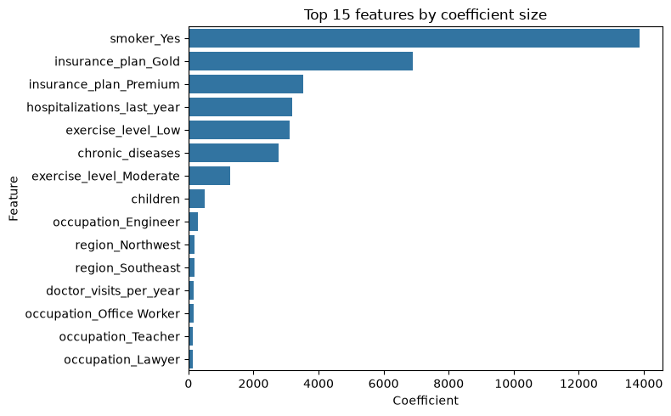
Learnings
5
What we took away and how AI was used
What worked
Linear Regression successfully predicts numerical insurance costs.
Personal and lifestyle information helps estimate insurance expenses.
Pandas made data processing easier.
Matplotlib helped visualize the results.
What didn't work
Prediction errors may occur because of differences between actual and predicted values.
Linear Regression may not capture all complex relationships in medical insurance costs.
Missing or incorrect data can affect model performance.
Smoking status dominates; region and occupation barely matter.
AI-use disclosure AI tools were used to support project understanding, code assistance and presentation preparation. The dataset processing, model implementation and result analysis were performed as part of our project work.
Notes:
What worked, what didn't, and the AI-use disclosure.

